Slide 1

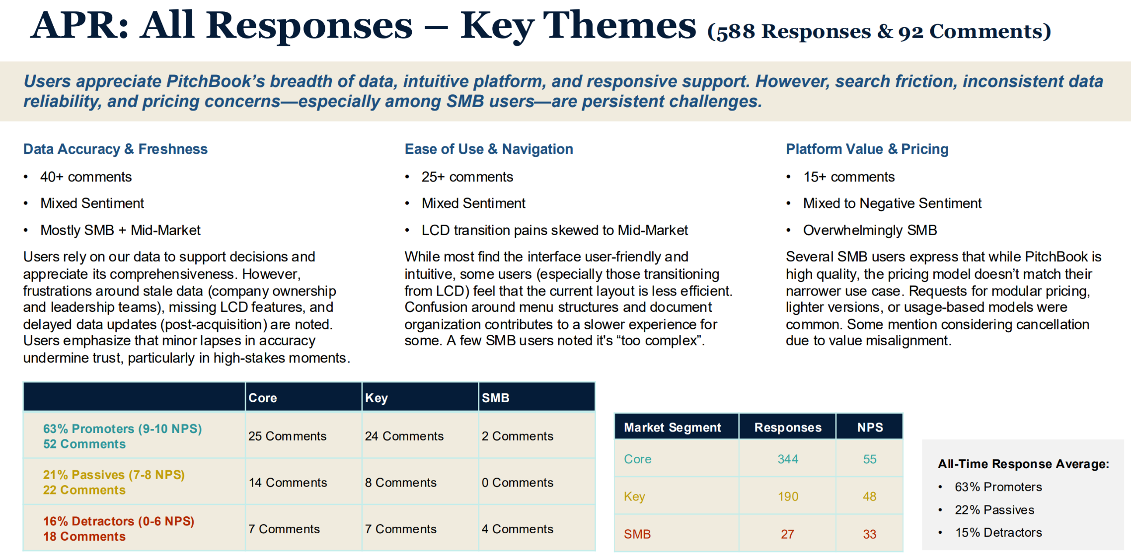
Pitchbook Data – Voice of the Customer AI Agent
Business Need
PitchBook’s Marketing team relied on manual, time-intensive processes to collect, synthesize, and present customer feedback across multiple platforms. Insights were fragmented across survey tools, analytics platforms, review sites, and conversation transcripts, making it difficult to quickly identify themes, prepare executive-ready summaries, and translate customer sentiment into actionable marketing narratives.
What We Did
Designed and implemented a Voice of the Customer Agent tailored for the Marketing organization
Unified customer feedback from surveys, analytics dashboards, review platforms, and conversation transcripts into a single analysis pipeline
Applied AI-powered sentiment analysis and thematic clustering to surface key trends, risks, and opportunities
Delivered templated, self-service outputs optimized for marketing presentations, executive readouts, and campaign planning
Enabled on-demand querying of customer insights to support faster messaging, positioning, and storytelling
Azure AI Foundry
Results
Reduced time spent compiling and analyzing customer feedback by approximately 60% and 40+ hours a month, accelerating insight-to-presentation workflows
Enabled Marketing teams to generate consistent, executive-ready slides and summaries without manual data stitching
Improved visibility into customer sentiment and recurring themes across channels
Established a scalable foundation for ongoing Voice of the Customer analysis

Slide 2

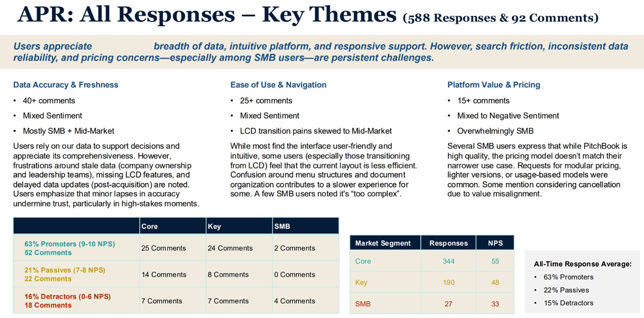
SaaS Software Company– AI Voice of Customer Agent
Overview
    Affirma’s client manually collected customer insights and satisfaction metrics across various feedback platforms. Affirma was engaged to architect an Azure AI agent to automate and improve this process.
Partnership Scope
    Conducted a comprehensive assessment of existing Voice of the Customer processes, tools, and data sources
    Designed a scalable architecture to unify feedback from Tableau, AskNicely, TrustRadius, and Gong transcripts into a single analysis pipeline
    Created a self-service feedback intelligence platform, empowering teams with quicker, on-demand access to insights leveraging Azure AI
Azure Open AI

Slide 3
Pitchbook Data– Azure AI Voice of Customer Agent
Overview
    Affirma’s client manually collected customer insights and satisfaction metrics across various feedback platforms. Affirma was engaged to architect an Azure AI agent to automate and improve this process.
Partnership Scope
    Conducted a comprehensive assessment of existing Voice of the Customer processes, tools, and data sources
    Designed a scalable architecture to unify feedback from Tableau, AskNicely, TrustRadius, and Gong transcripts into a single analysis pipeline
    Created a self-service feedback intelligence platform, empowering teams with quicker, on-demand access to insights leveraging Azure AI
Azure AI Foundry

